Slide 1


Welcome to

Slide 2


Bob Prouty
2,000 missionaries in over 150 countries.
helping establish vital, multiplying and sustainable churches and faith communities,
one for every thousand people,
in every rural village, suburban neighborhood, urban high-rise and digital community.
We have helped people start over 1.8 million churches in the past ten years.

Slide 3

Our goal
to help your team establish multiplying spiritual communities by following the model that Jesus showed us.

Slide 4


What is the road ahead?
generations.myfriends.network

Slide 5
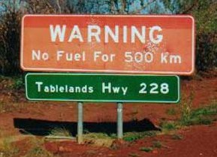
How often will we be stopping for fuel?
We will be meeting fortnightly

Slide 6

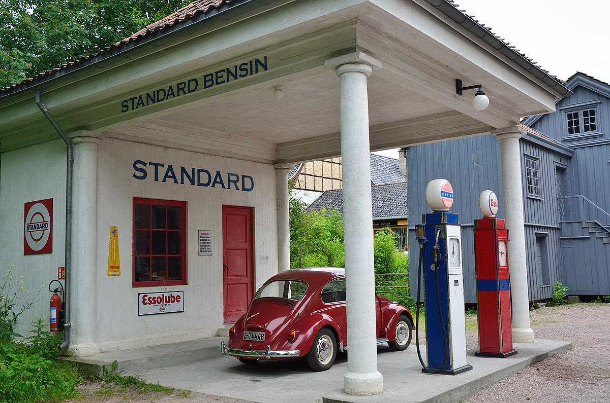
11 stops
When you study the life a Christ in chronological order you will see five distinct phases in the way Jesus built his movement of multiplying faith communities.
In Explore we will focus on the first two phases.

Slide 7


Up to 29 stops
– depending on needs
Develop assists leaders grow in:
Equipping Believers to do the works of service (ministry)
Shepherding (care for, watch over)
Being an example in character and lifestyle
Developing other leaders

Slide 8

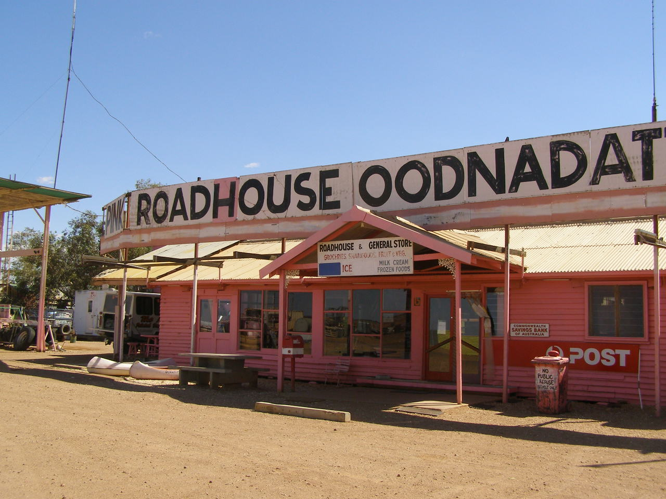
From time to time we will get together for peer coaching
As iron sharpens iron, one man sharpens another. ( Proverbs 27:17 )

Slide 9

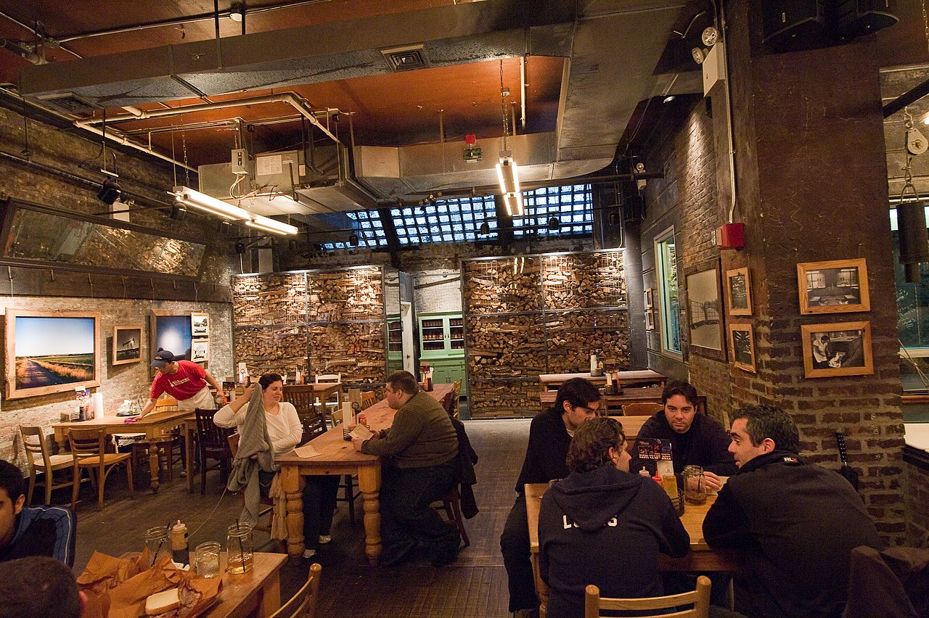
Whenever something good happens
Record what God has done so you can celebrate with others.
This section is still under development

Slide 10
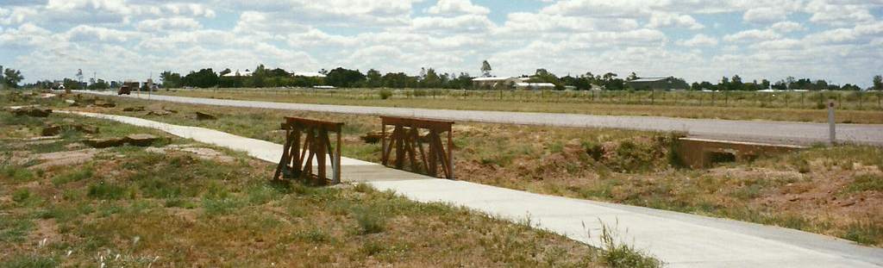
How long is the journey?
How long will it take for you to start a church that multiplies?
We have content for 2 years
This Photo by Unknown Author is licensed under CC BY-NC

Slide 11

An important definition
Churches and spiritual communities can take many forms.
We define a church as 10 or more followers of Christ practicing Acts 2:42-47

Slide 12

Now let’s move to the website/app
generations.myfriends.network

